Slide 1
T2WML Table To Wikidata Mapping Language
Daniel Garijo, Pedro Szekely
Information Sciences Institute and Department of Computer Science
@dgarijov, @szeke {dgarijo, pszekely}@isi.edu

Slide 2
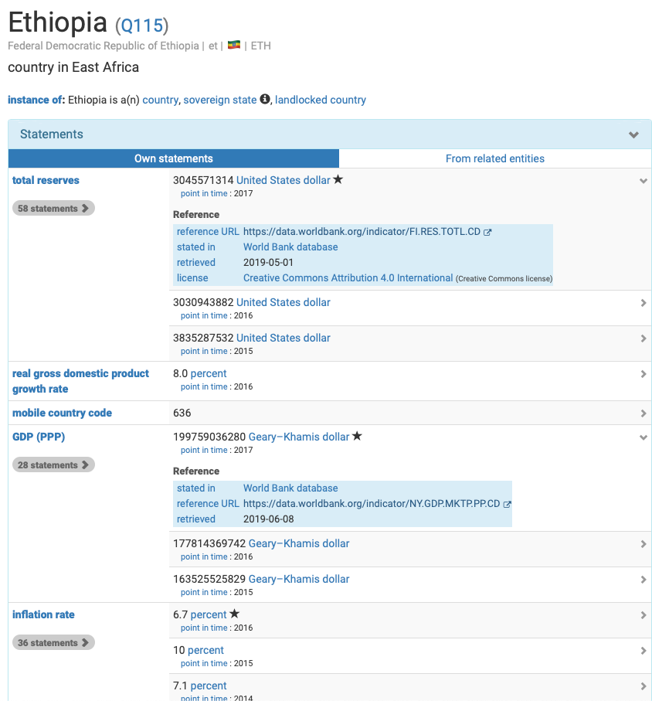
Motivating Example
World Bank
Indicators
Only a few indicators present for each country

Slide 3
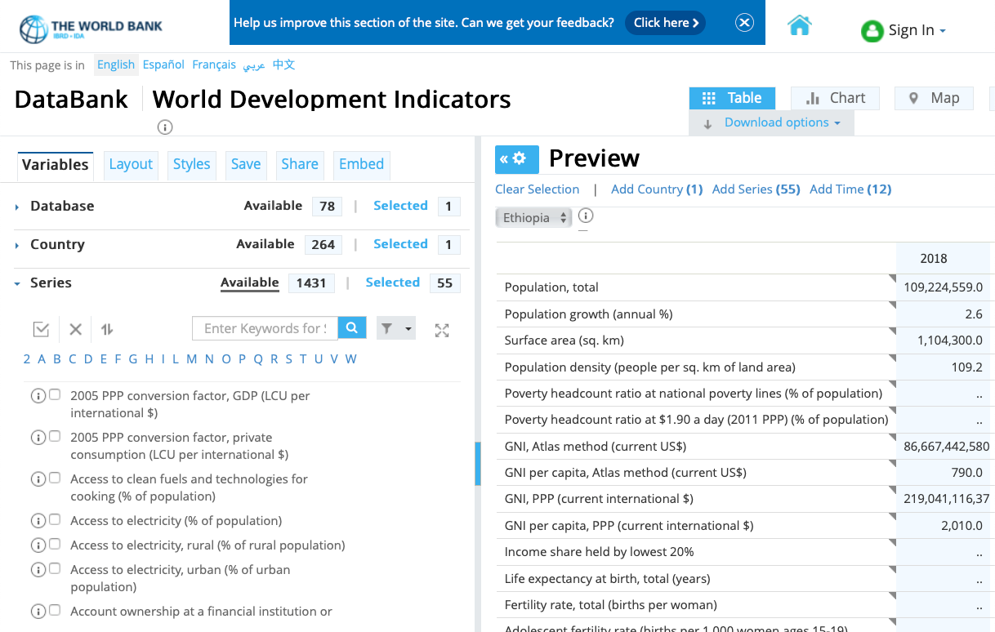
World Bank: 1,431 Indicators For Ethiopia

Slide 4
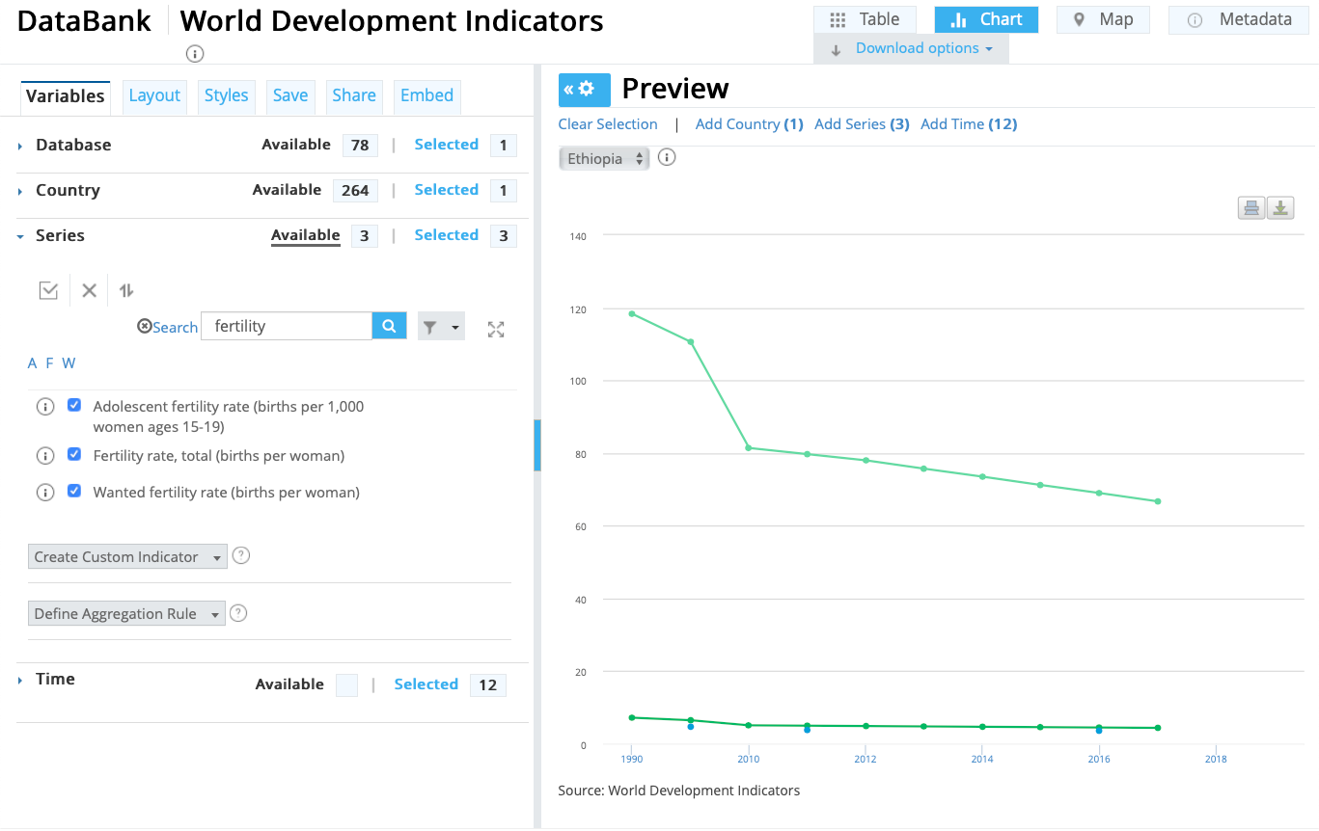
Indicator Examples
How to add all indicators to Wikidata?

Slide 5
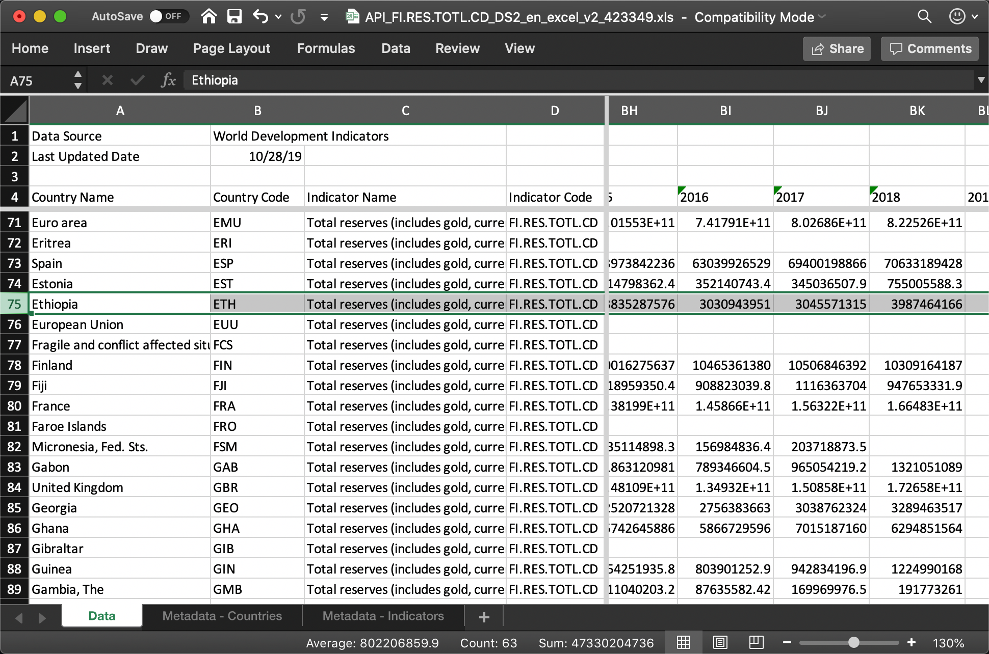
Indicator Excel File

Slide 6
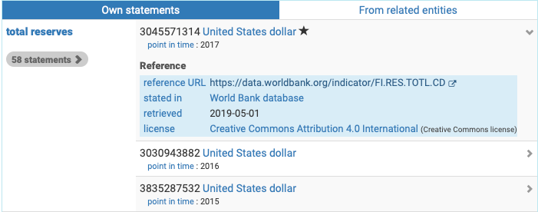
Mapping Data To Wikidata Statements

Slide 7
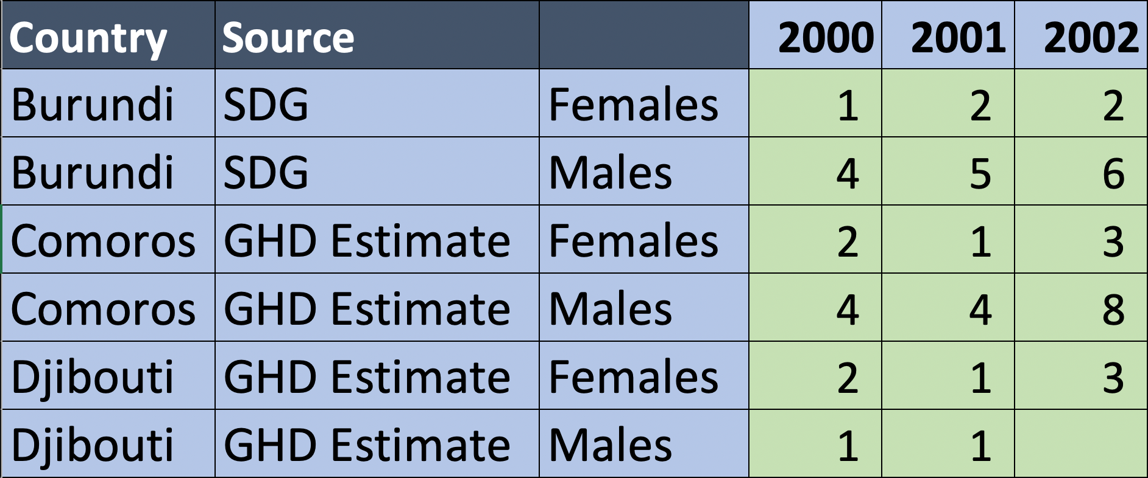
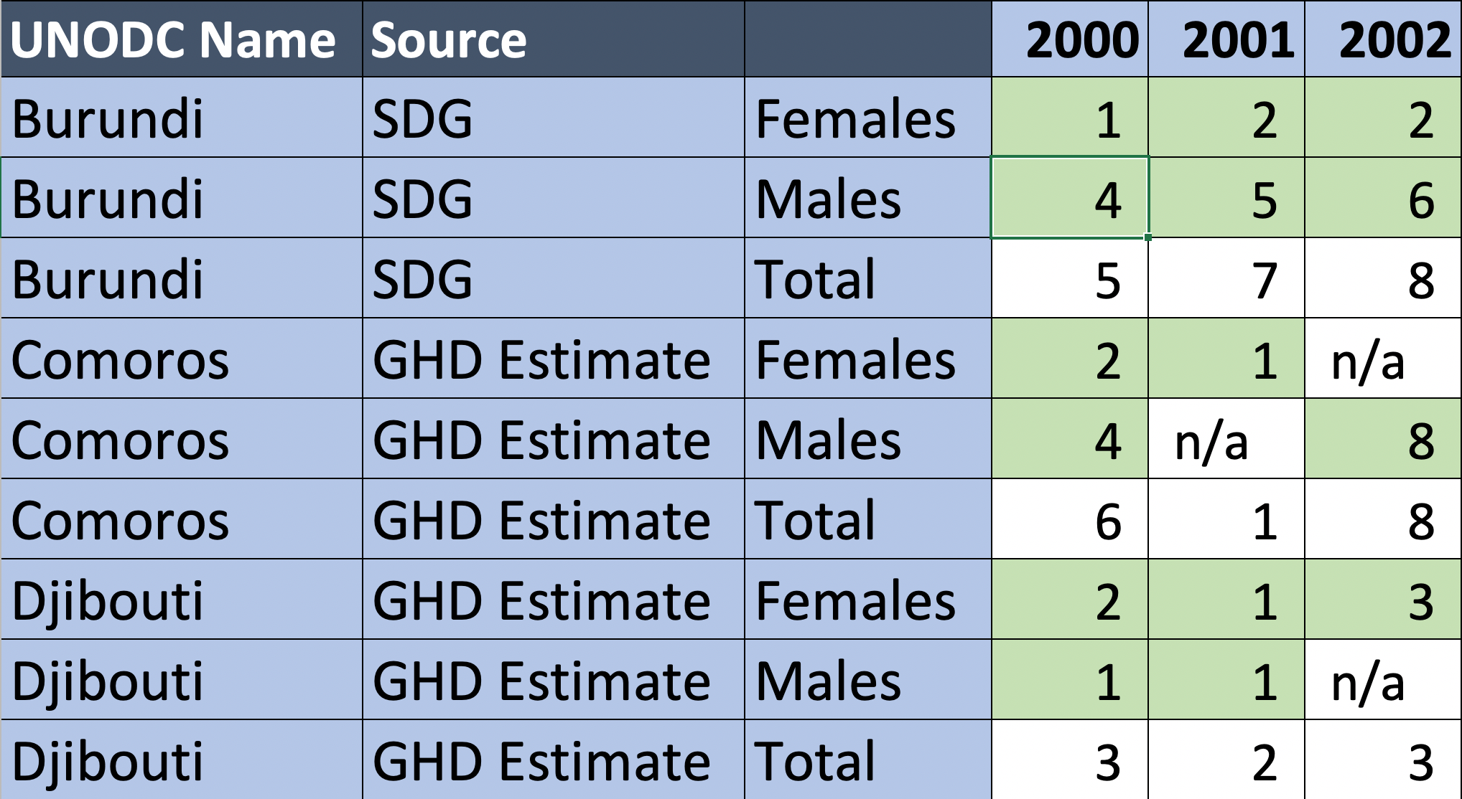
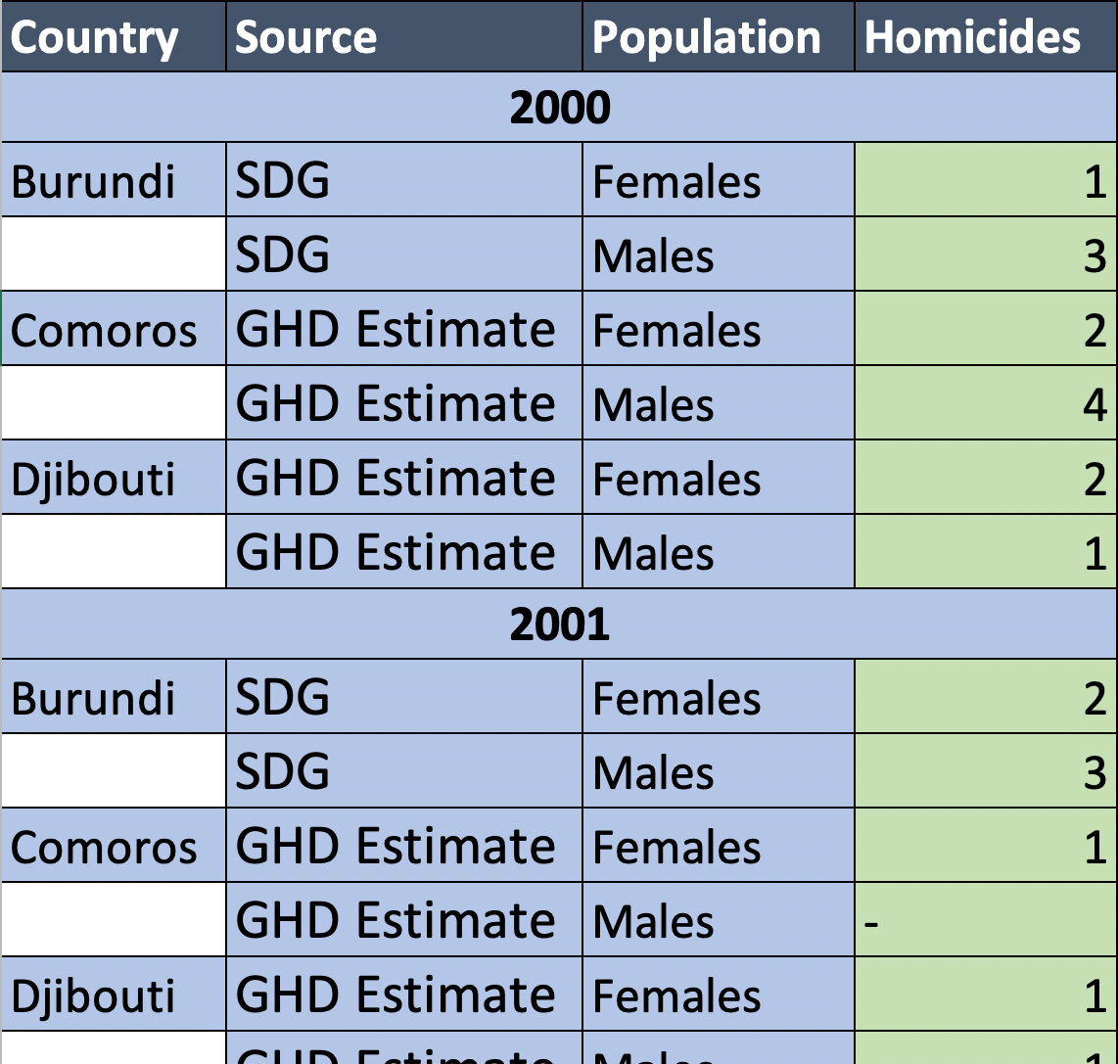
Challenge: Different Shapes & Layouts
Same Data

Slide 8
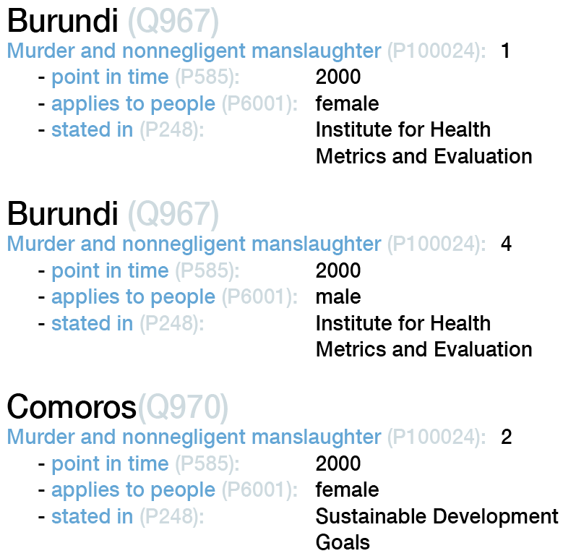
Wikidata Statements

Slide 9
Table To Wikidata Mapping Language

Slide 10
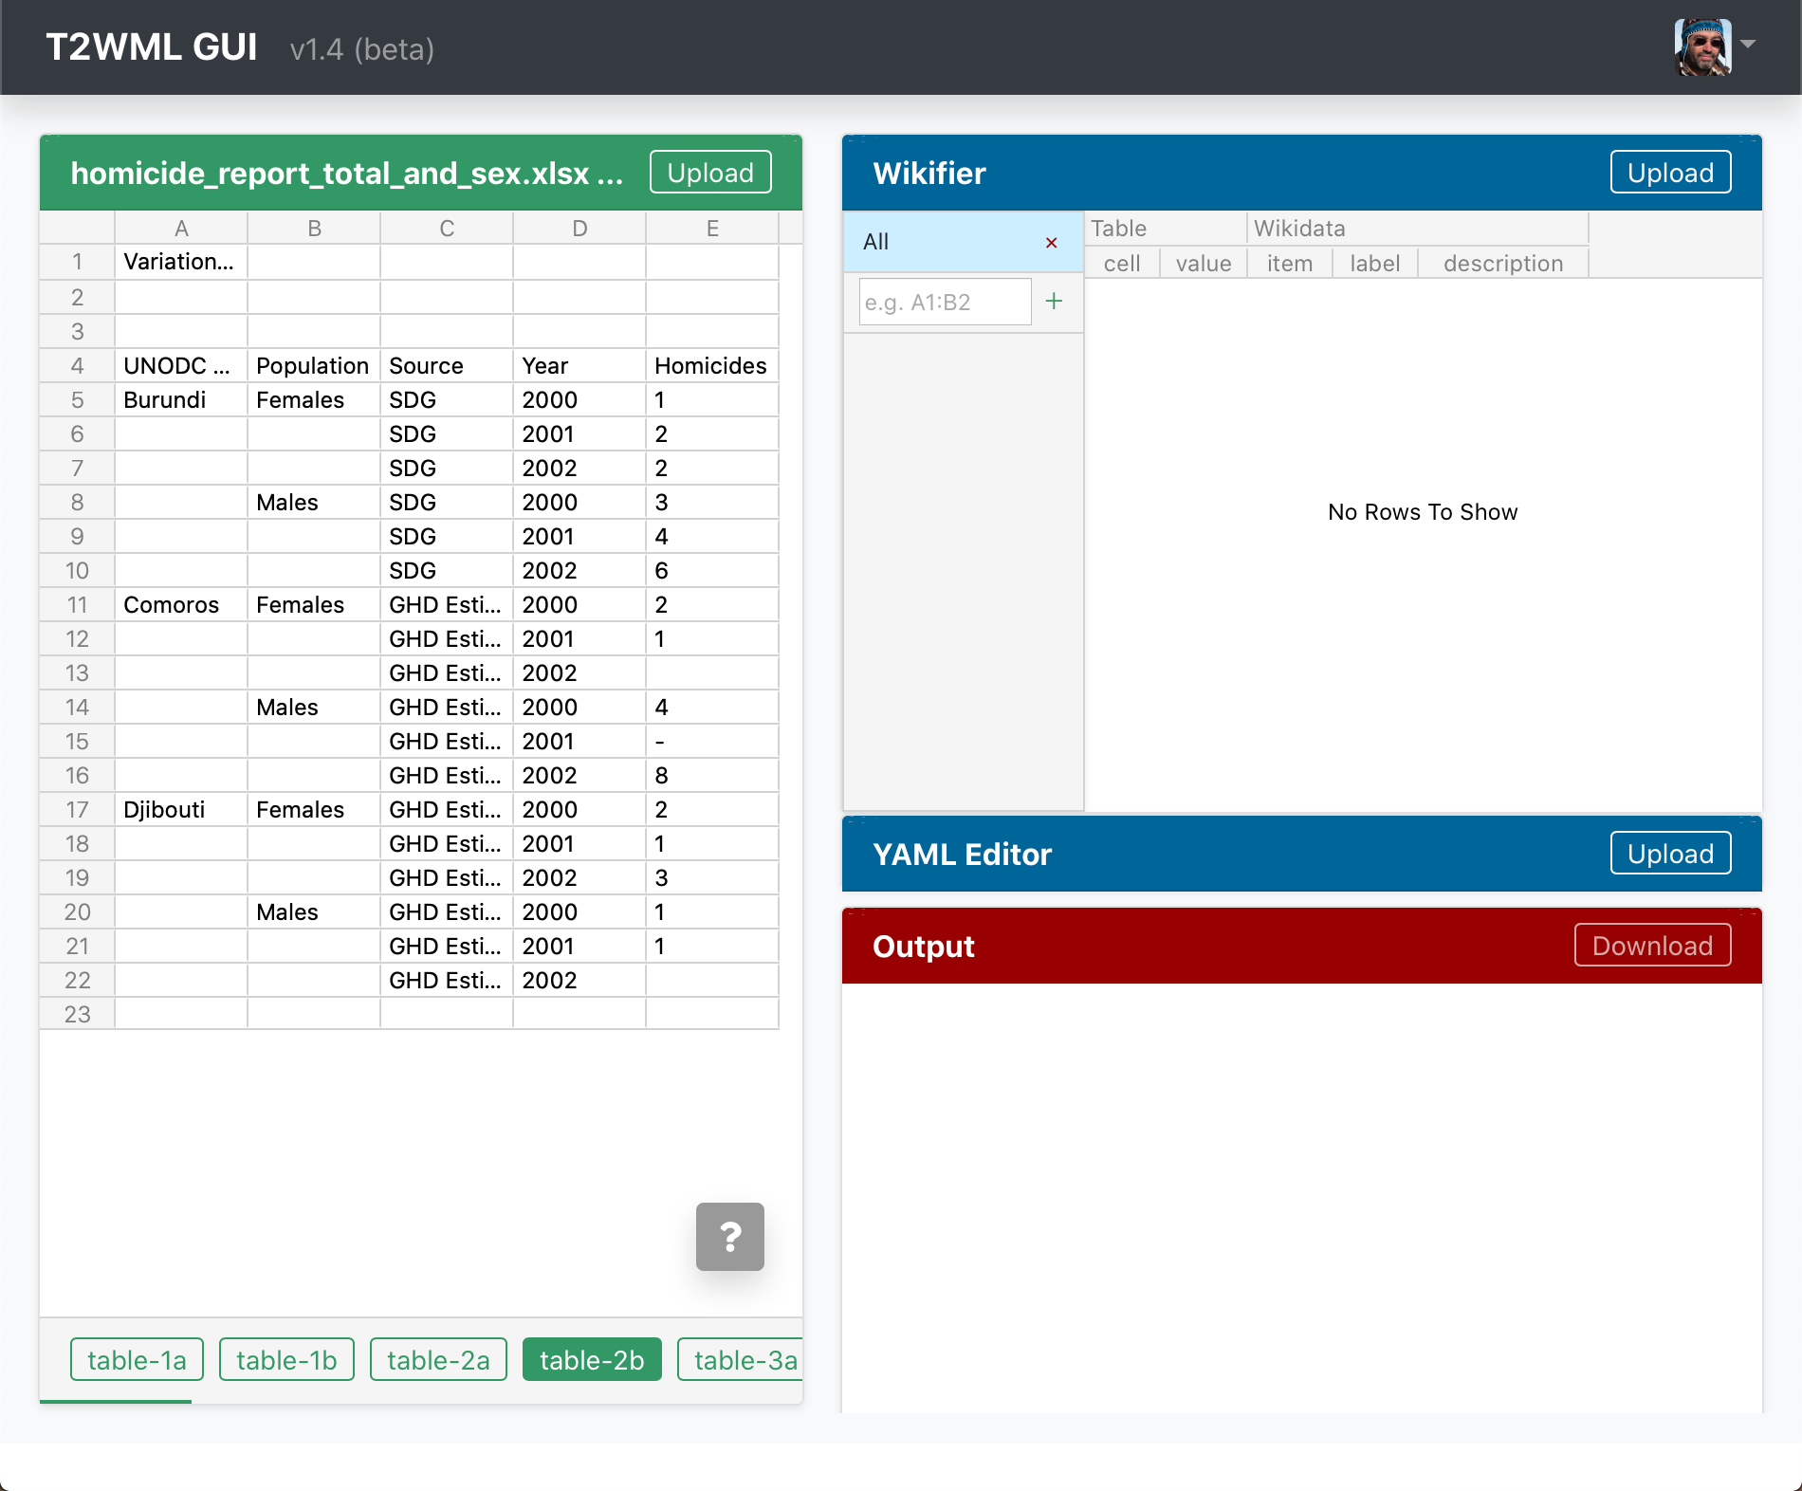
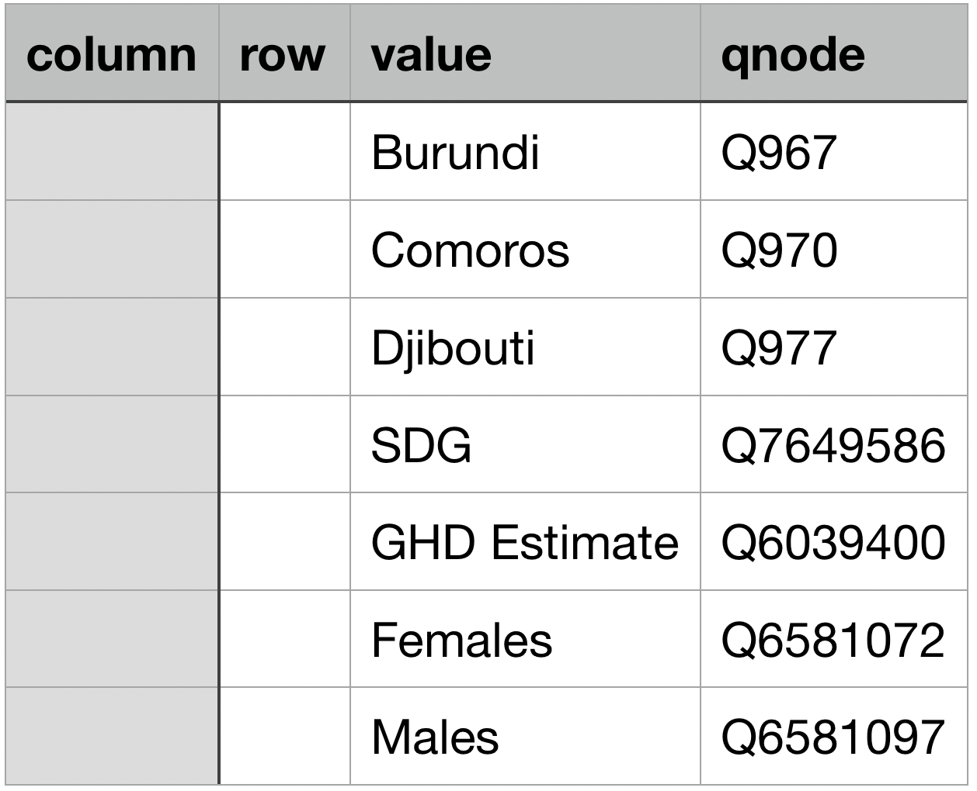
Workflow
Step 1
Load the data

Slide 11
Workflow
Step 2
Link cell values to Wikidata

Slide 12
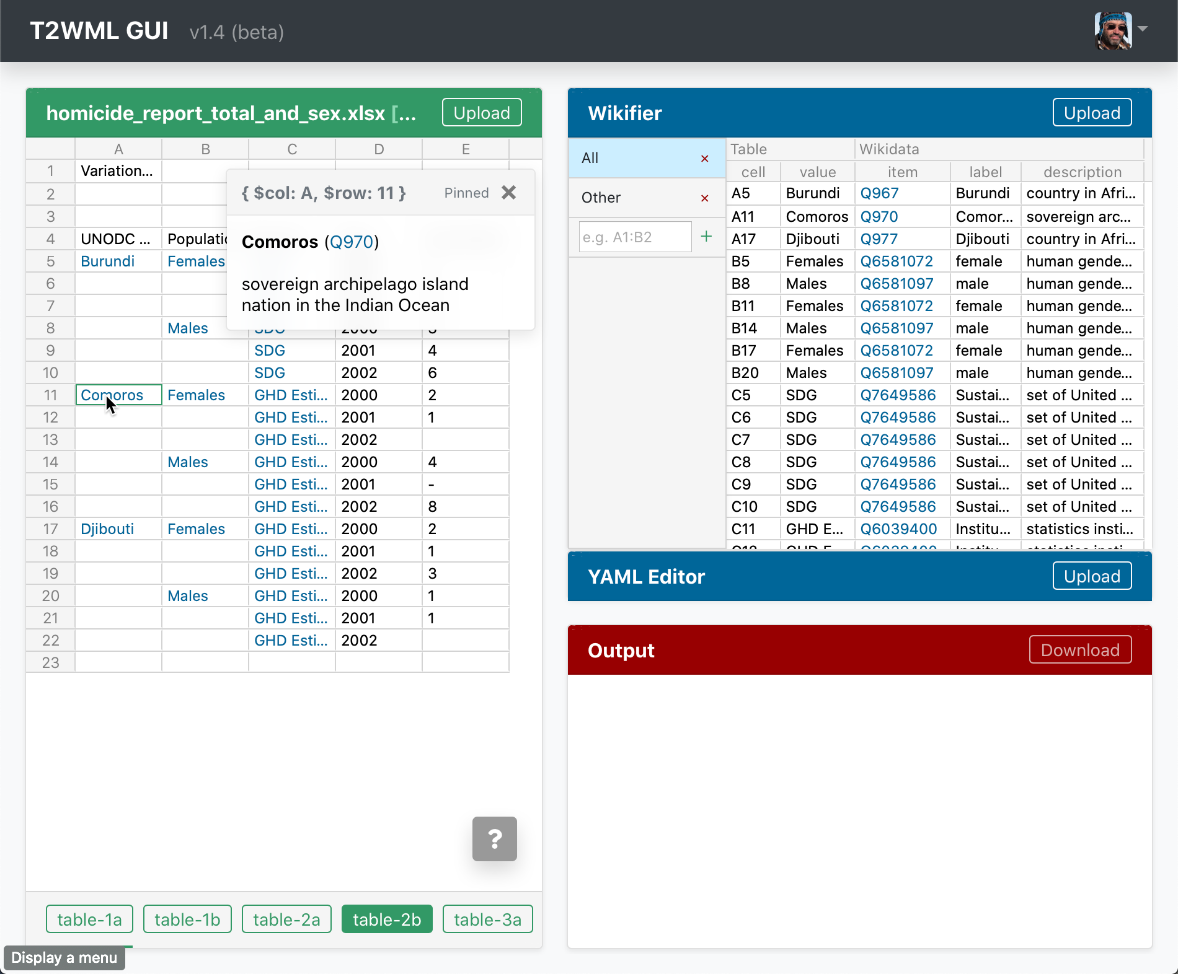
Step 2
Link cell values to Wikidata

Slide 13
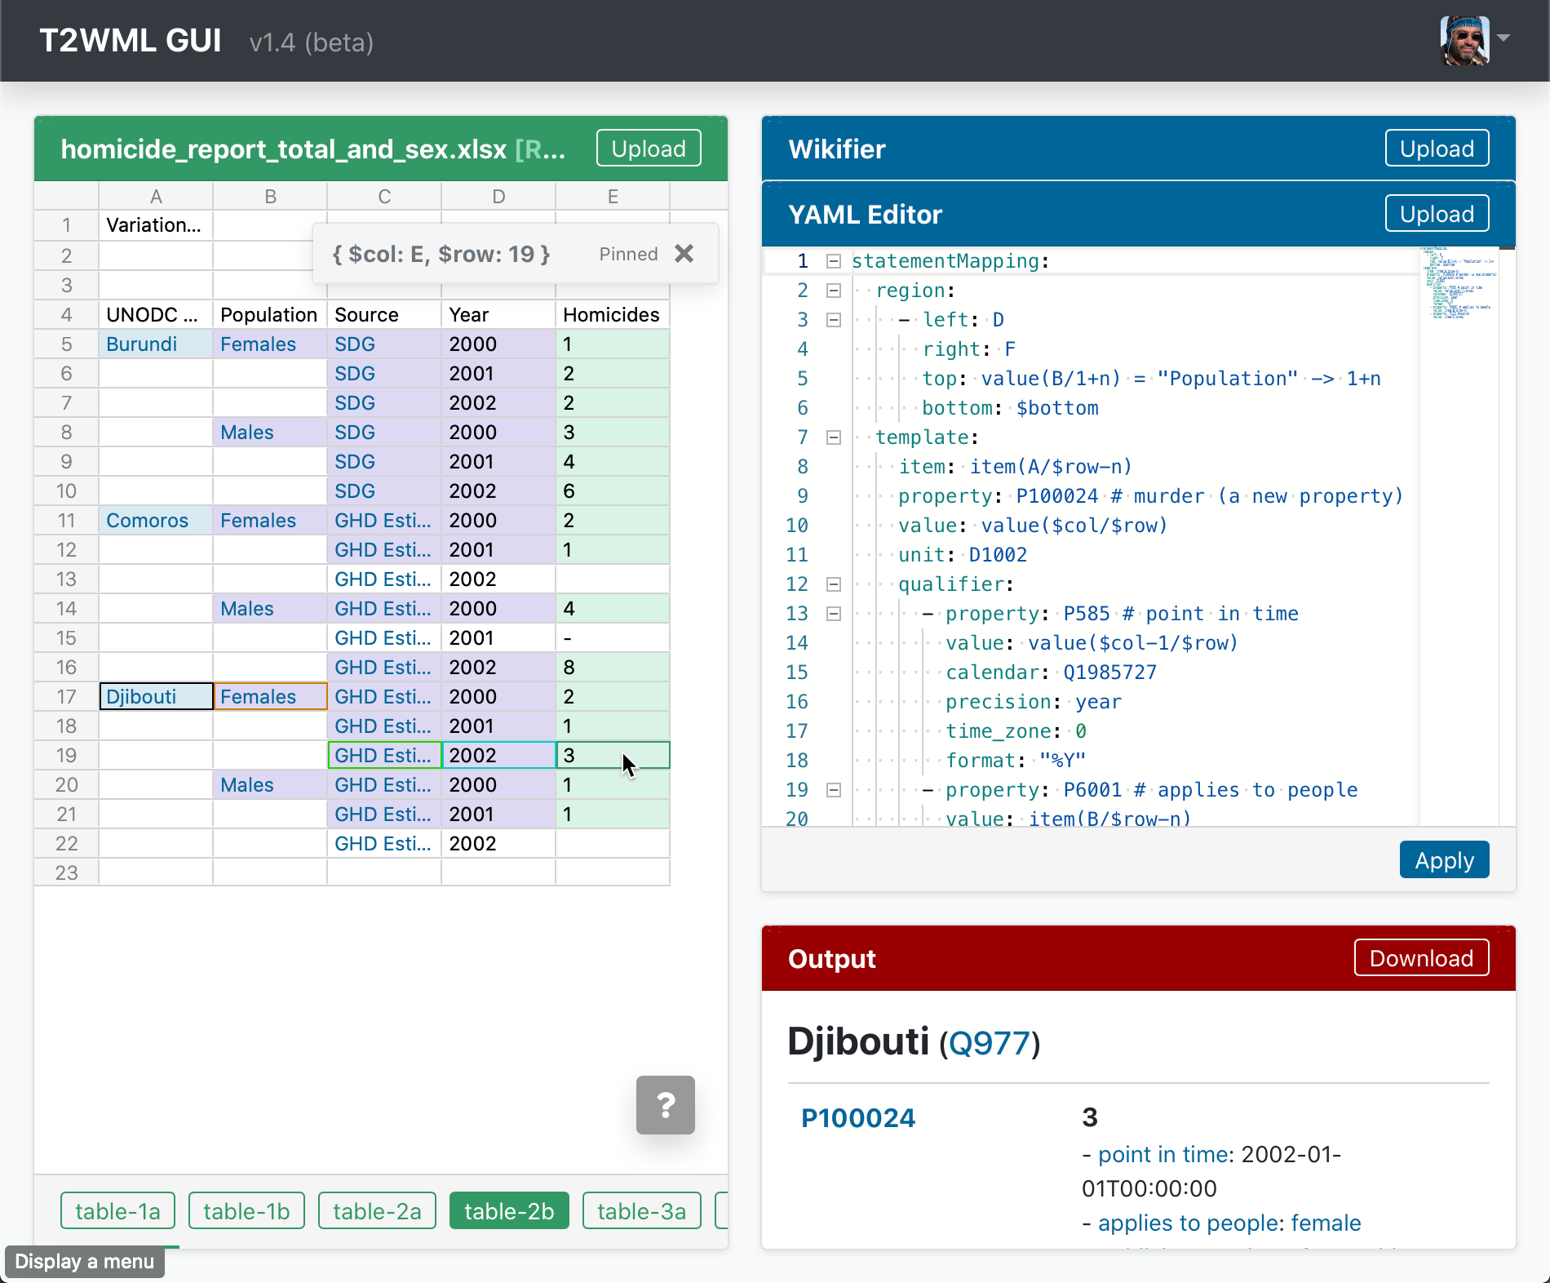
Step 3
Map table to Wikidata

Slide 14
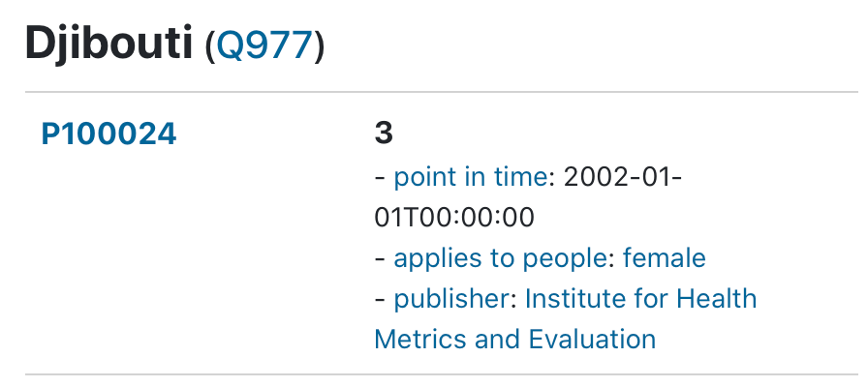
T2WML: Two Ideas
1) define data region
2) define mapping for one cell

Slide 15
1) define data region
region defined using constants
region:
- left: D
right: F
top: 4
bottom: $bottom

Slide 16
1) define data region
region defined using constants
region:
- left: D
right: F
top: 4
bottom: $bottom
region robust to variable # of header rows
region:
- left: D
right: F
top: value(B/1+n) =
"Population" -> 1+n
bottom: $bottom
- in column B, start at row 1
- search down for a cell containing “Population”
- return the row where it was found

Slide 17
2a) define mapping for one cell
for cell in $col/$row
item: item(A/$row-n)
property: P100024 # murder
value: value($col/$row)
in column A, go up until you find a
cell mapped to a Wikidata item
the property is P100024 for all cells
the value is the contents of the current cell

Slide 18
2a) define mapping for one cell
for cell in $col/$row
item: item(A/$row-n)
property: P100024 # murder
value: value($col/$row)

Slide 19
2b) define ”point in time” qualifier
for cell in $col/$row
property: P585 # point in time
value: value($col-1/$row)
calendar: Q1985727
precision: year
time_zone: 0
format: "%Y"
the year is in the column to the left

Slide 20
2c) define ”applies to people” qualifier
for cell in $col/$row
property: P6001 # applies to
# people
value: item(B/$row-n)
- the value is in column B
- need to go up from the current row until finding an item mapped
to Wikidata

Slide 21
T2WML Specification
statementMapping:
region:
- left: D
right: F
top: value(B/1+n) = "Population" -> 1+n
bottom: $bottom
template:
item: item(A/$row-n)
property: P100024 # murder (new property)
value: value($col/$row)
unit: D1002 (a new property)
qualifier:
- property: P585 # point in time
value: value($col-1/$row)
calendar: Q1985727
precision: year
time_zone: 0
format: "%Y"
- property: P6001 # applies to people
value: item(B/$row-n)
- property: P123 # source
value: item(C/$row)

Slide 22
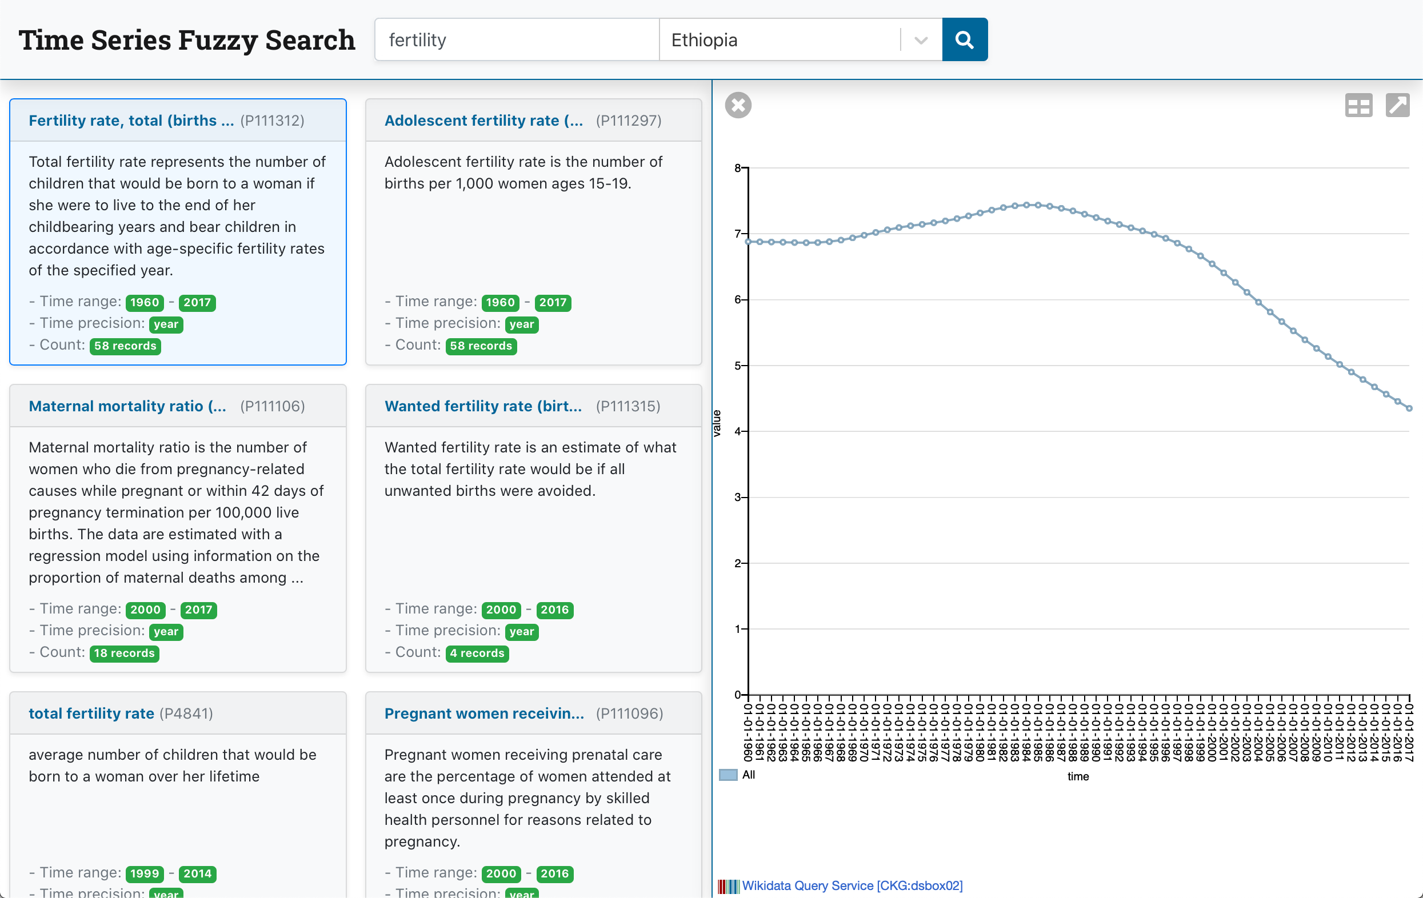
World Bank Indicators in Wikidata

Slide 23
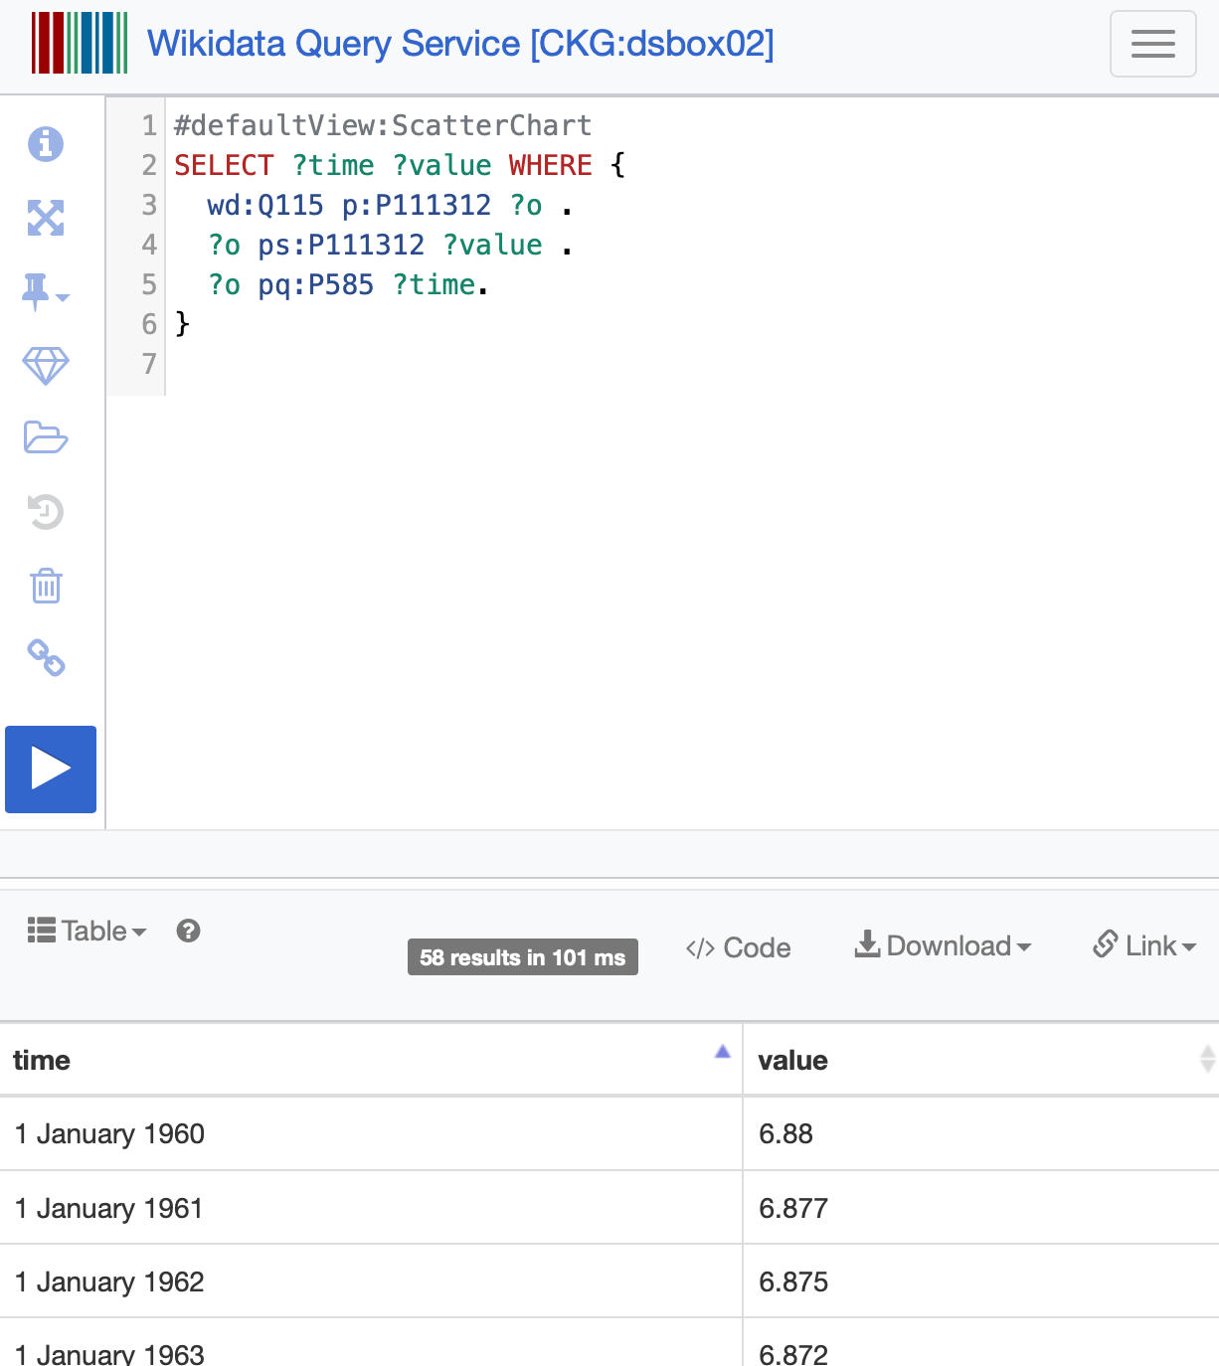
World Bank Indicators in Wikidata

